Slide 1
Mining and its affects on climate change
By Good as Gold but Greener
Members: Gabriel Tate
Notes:
Hello my name is Gabriel Tate in my presentation I am going to discuss a little bit about mining as well as how it affects climate change.

Slide 2
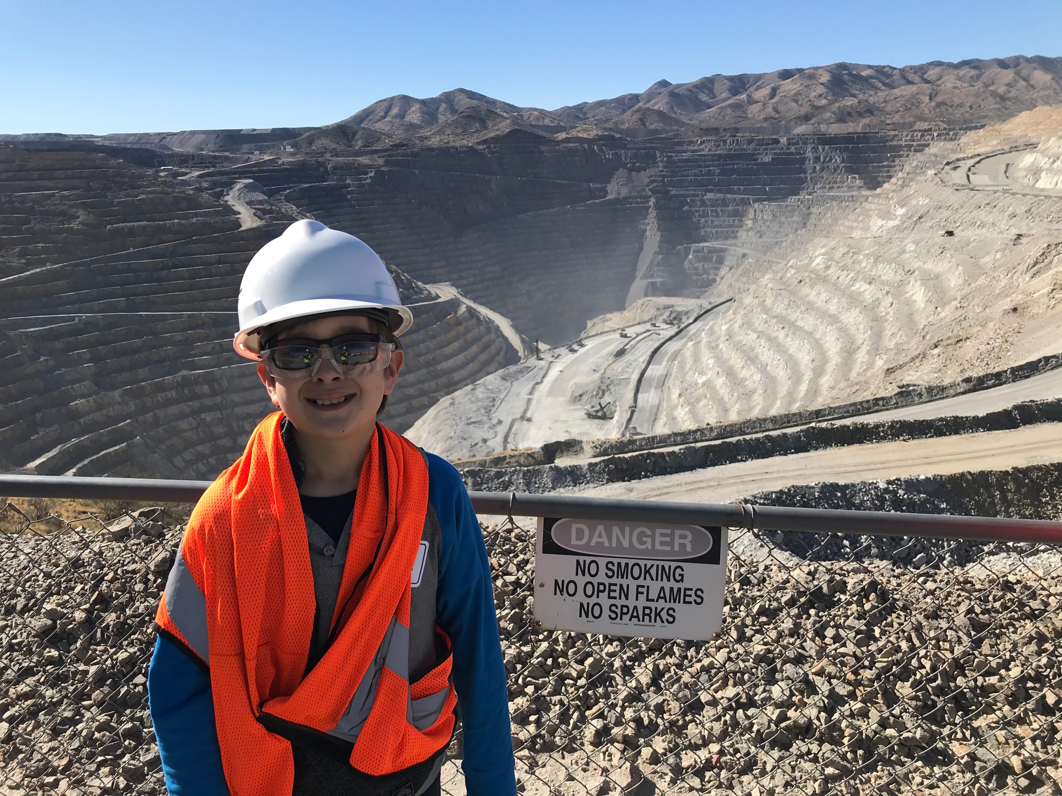
General action step
Possibly change opinion
Notes:
I think that many people are of the opinion that mining leads to lots of climate change which may be true. However I am of the opinion that it’s benefits outweigh the negatives.

Slide 3
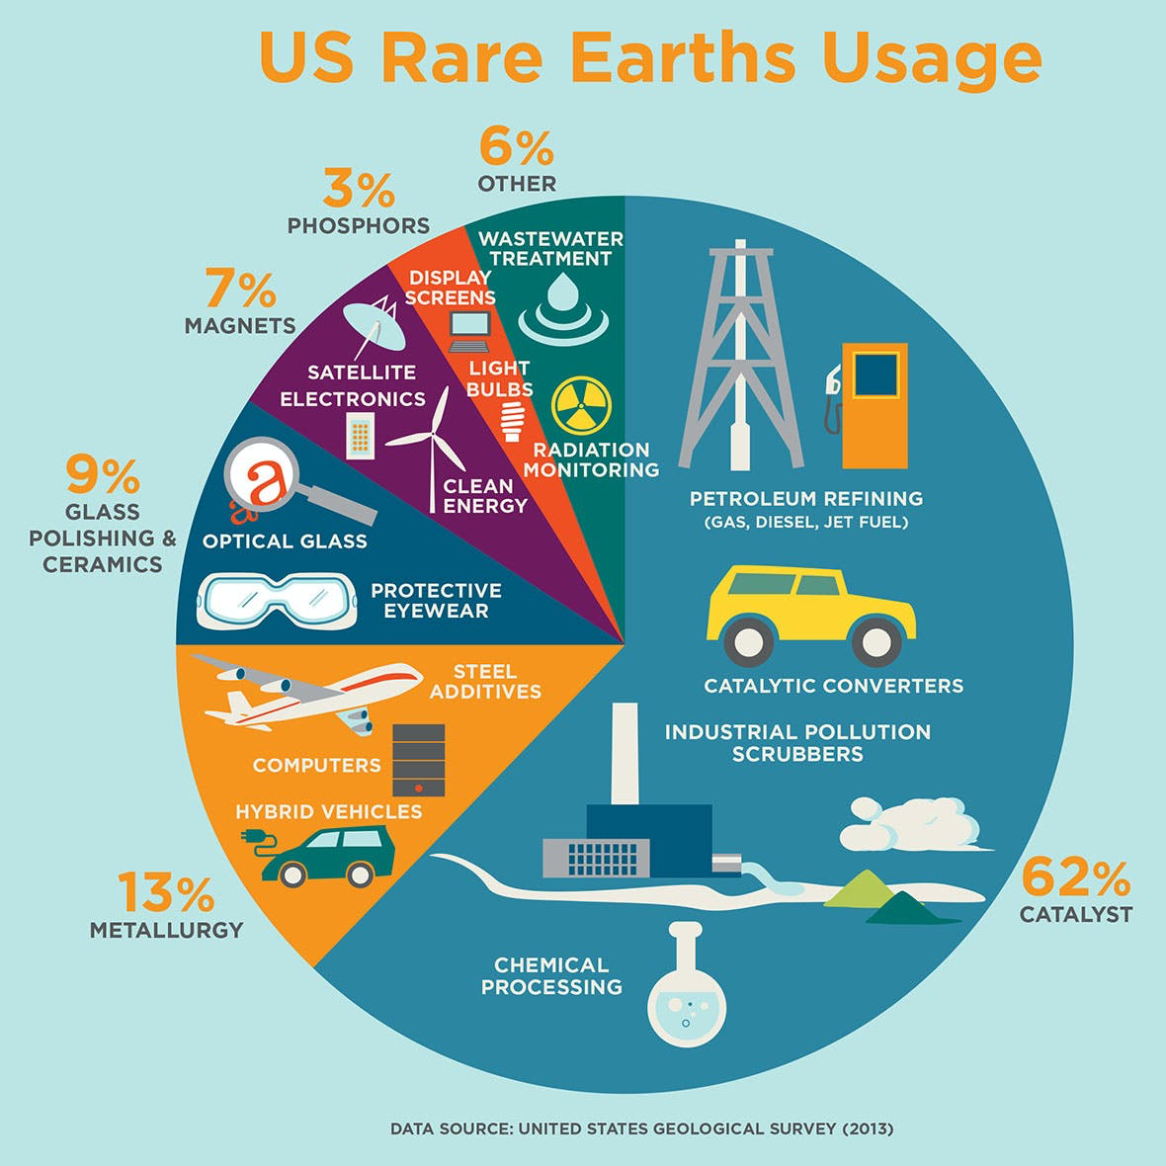
Benefits of mining
Metals and other materials that are used in climate change reduction
Rare earth elements
Essential parts of high tech and climate change reducing technologies
Solar panels, wind turbines, and dams
Notes:
One of the main topics in this presentation is the benefits of mining. One of the benefits of mining is the materials produced from mining. A important one for climate change reduction is rare earth elements (REEs.) The materials can be used in technologies that are used in climate change reduction. A few examples are wind turbines, solar panels, and carbon scrubbers.

Slide 4
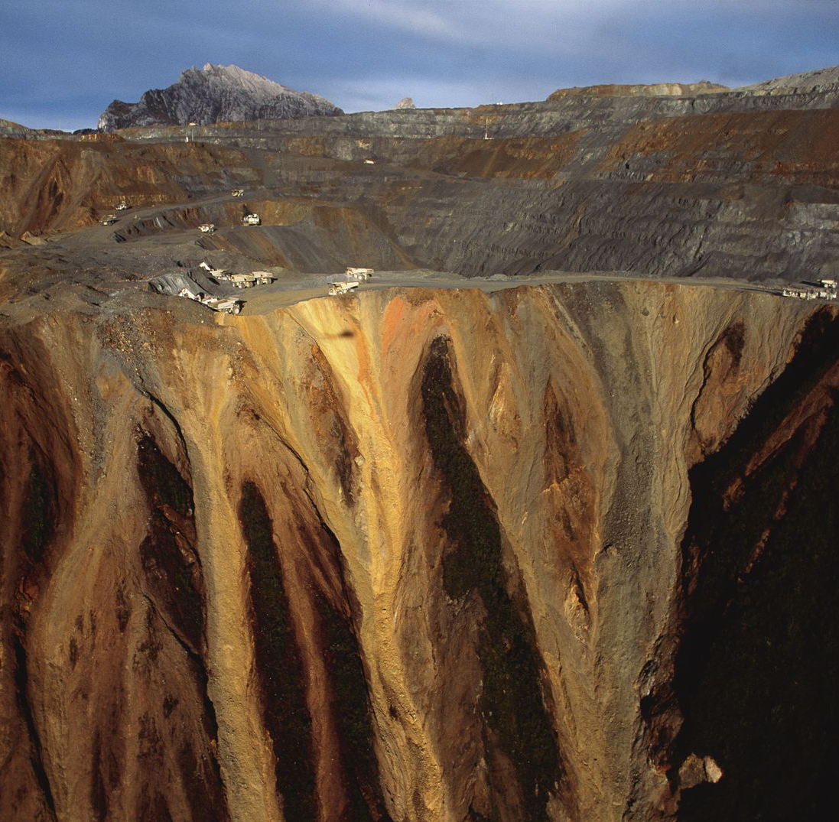
Downsides of mining affecting climate change
Green house gases from equipment
Water pollution
Land problems/pollution
Fossil fuels
From mining
Used by mining
Notes:
Though there are several benefits to mining, it also has its downsides. Which include greenhouse gasses, water pollution, land destruction, and fossil fuels.

Slide 5
Green house gasses
Produces green house gasses
Notes:
Mining also produces greenhouse gasses in several ways. One way is through the equipment being used. There can be a large output of greenhouse gasses from that.

Slide 6
Fossil fuel
Producing lots of fossil fuels that lead to more air and water pollution
Notes:
The other way is through producing fossil fuels used by other things which leads to more pollution.

Slide 7
What can be done
What miners are doing
Use REEs
Notes:
Though there are downsides things can still be done to help mitigate them.

Slide 8
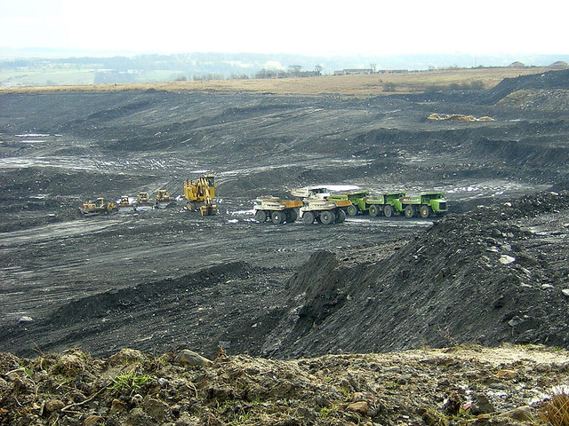
What miners are doing
Reclamation
Finding ways to reduce carbon
Notes:
Mines also have ways of dealing with issues they cause. Such as reclaiming used land and giving it back to the public. As well as finding new ways they can reduce their carbon emissions.

Slide 9
Using REEs
REEs are used in many green energy items
Notes:
Another way to reduce climate change is to start using more renewable energy sources provided by Rare Earth Elements.

Slide 10
Conclusion
Mining provides both benefits as wells as drawbacks for climate change
Notes:
In conclusion, Mining provides both benefits and negatives for climate change, and the benefits outway the negatives, because the negatives are being minimized.

